Slide 1
*VIRTUAL*
IBM Z Council West Coast
Dec 2, 2021 | 10:00 AM – 1:00 PM PST
We will be starting shortly!

Slide 2
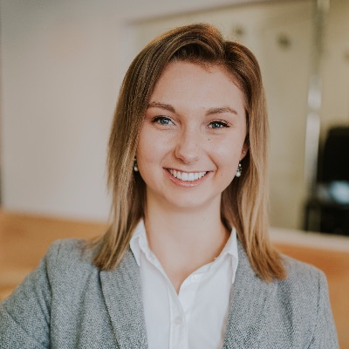
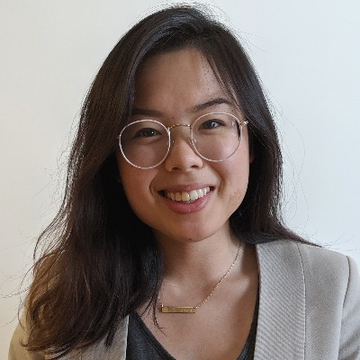
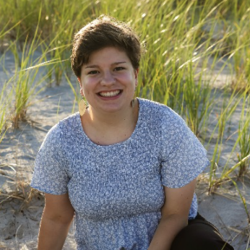
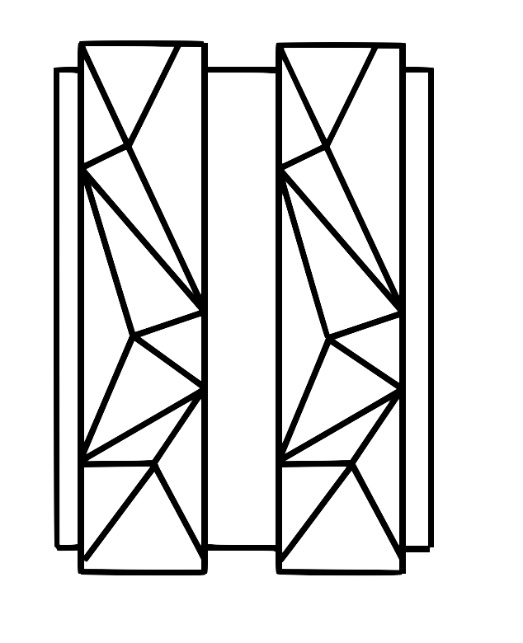
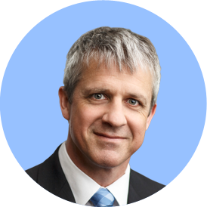
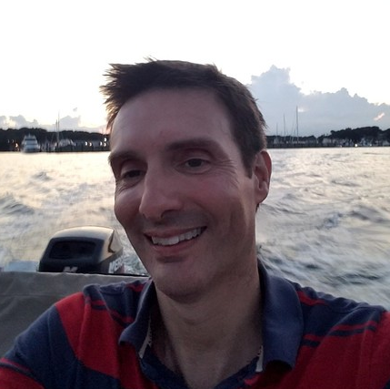
Welcome from our team
Z Council Leadership Team
Keziah Knopp Thuy-Mi Le Kiri Nicholson
Our Distinguished Speakers
Andrew Bowker Larry Strickland Kiri Nicholson Steve Warren
© 2018 IBM Corporation

Slide 3
Agenda (PST)
10:00 AM PDT | Welcome & Opening Remarks
10:05 AM – 10:55 AM PDT | Performance Increasing IBM Z Table Accelerator Andrew Bowker – Offering Manager, IBM Z Table Accelerator Larry Strickland – Chief Product Officer, DataKinetics
10:55 AM – 11:00 AM PDT | Short Break
11:00 AM – 11:50 AM PDT | IBM Telum Microprocessor Kiri Nicholson – IBM Z Hardware Client Technical Specialist
11:50 AM – 12:00 PM PDT | Short Break
12:00 PM – 12:50 PM PDT | Exciting z/OS 2.5 Updates Steve Warren, IBM Z Systems Technology Architect
12:50 PM – 1:00 PM PDT | Wrap Up & Closing Remarks
© 2018 IBM Corporation

Slide 4
Attend More Z Virtual Events!
Dec 6 – IBM Z AIOps Virtual Lab – Service Management Unite & ChatOps
Dec 7 – Southeast Virtual Z Customer Council
Dec 8 – MQ Smart Seminar
And MORE!!!
More events, information, times and topics can be found here:
https://ibm-zcouncil.com/events/
© 2018 IBM Corporation

Slide 5
During the Event
Please use the Q&A section for questions during presentations.
Send to ALL PANELISTS
After each presentation, you may raise your hand to be unmuted and ask a live question.
© 2018 IBM Corporation

Slide 6
After the Event
Presentation decks will be posted on the event registration page.
Recordings will be sent to attendees who complete the event survey.
© 2018 IBM Corporation

Slide 7
Agenda (PST)
10:00 AM PDT | Welcome & Opening Remarks
10:05 AM – 10:55 AM PDT | Performance Increasing IBM Z Table Accelerator Andrew Bowker – Offering Manager, IBM Z Table Accelerator Larry Strickland – Chief Product Officer, DataKinetics
10:55 AM – 11:00 AM PDT | Short Break
11:00 AM – 11:50 AM PDT | IBM Telum Microprocessor Kiri Nicholson – IBM Z Hardware Client Technical Specialist
11:50 AM – 12:00 PM PDT | Short Break
12:00 PM – 12:50 PM PDT | Exciting z/OS 2.5 Updates Steve Warren, IBM Z Systems Technology Architect
12:50 PM – 1:00 PM PDT | Wrap Up & Closing Remarks
© 2018 IBM Corporation

Slide 8
Break Time
We will resume at 11:00 AM PST
With Kiri Nicholson and IBM Telum Microprocessor
Please fill out our survey:
ibm.biz/4q21-westz
and link in chat!
© 2018 IBM Corporation

Slide 9
Break Time
We will resume at 11:40 PST
with Steve Warren and Exciting z/OS 2.5 Updates
Please fill out our survey:
ibm.biz/4q21-westz
and link in chat!
© 2018 IBM Corporation

Slide 10
Thank you!
Follow-up info will come in an email directly from Webex in the next hour
Please fill out our survey:
ibm.biz/4q21-westz
and link in chat!
© 2018 IBM Corporation

Slide 11
